Slide 1
Kahoot Solver Bot
By Alisher Yokubjonov

Slide 2
What it is:
Kahoot bot solves stationary kahoot quizzes that are taken individually.
The bot is based on Selenium and Python.
Selenium is a tool for automating web activity.
This is an independent project and I’ve received no personal guidance along the way.

Slide 3
How and Why I made it.
HOW (the research process)
Video Tutorials
I watched a few youtube videos on selenium.
Stackoverflow
Googled my errors and searched for ways to solve problems.
What I used to make it
Selenium with Python
Inspect Element
WHY (the incentive)
Lack of options-
Other kahoot bots didn’t fit my needs. Didn’t work with private kahoots or didn’t answer questions correctly.
Practice and Interest-
I was interested in applying my knowledge to create something I’d personally use. Now that we’re in quarantine, many of my teachers assign kahoot quizzes which my bot can help with.

Slide 4
HOW IT WORKS
Collects data by function collect_data()
Bot signs up for specific kahoot under anonymous name
Picks random answer
Retrieves correct answer
Answers questions under preferred name by function kahoot()
Bot signs up for specific kahoot under user selected name
Picks the right answers

Slide 5
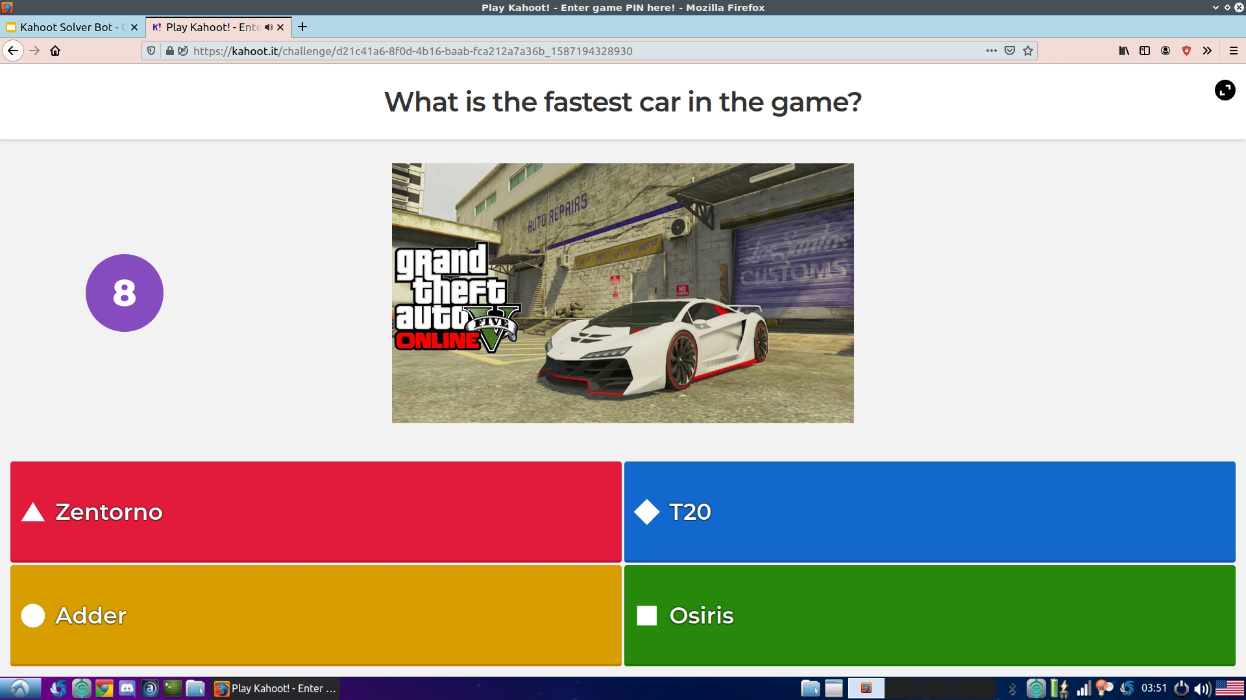
How the bot retrieves the correct answer:
Chooses the first answer

Slide 6
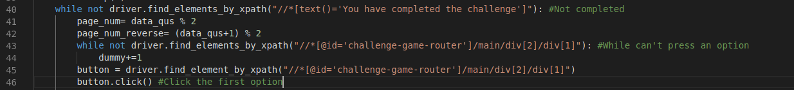

Slide 7
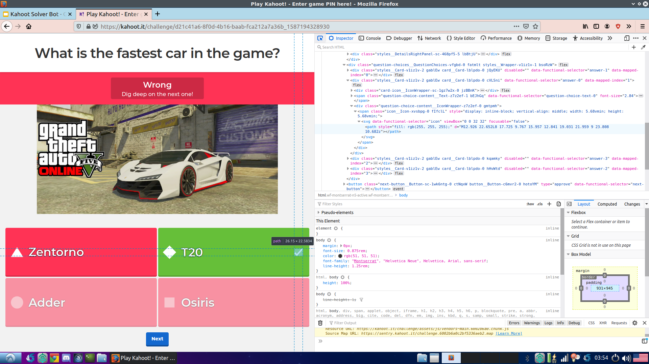
Finds the checkmark element using Selenium’s find_element_by_xpath().
Reaches the parent element which is the correct answer (T20).
Appends the correct answer to the list of correct answers.

Slide 8
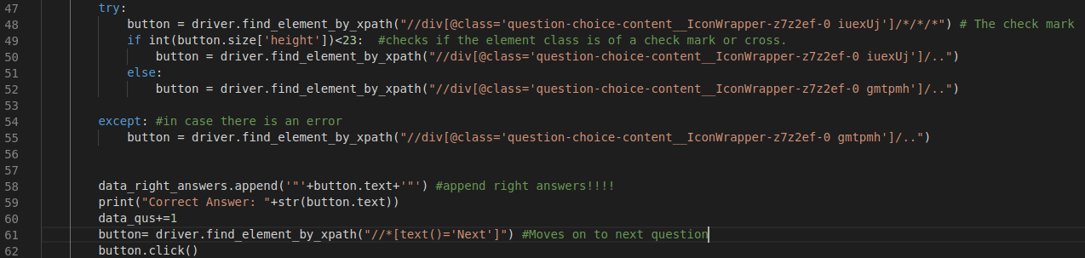

Slide 9
Biggest difficulties encountered along the way:
Problem 1:
Finding the checkmark element.
Solution:
Turns out checkmark element is always under the same two parents.
It was always either “class=question-choice-content__IconWrapper-z7z2ef-0 iuexUj”
Or “class = question-choice-content__IconWrapper-z7z2ef-0 gmtpmh”
Sometimes kahoot would have one checkmark and one X-mark. This made it hard for the bot to identify the correct answer. Example:
Solution :
Check the size of the element before assuming it’s correct.
Problem 2:
Notes:
Checkmarks and Xmarks are different sizes. Checking the size allows you to see which one it is.

Slide 10
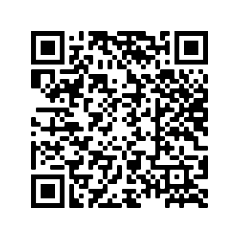
The end.
You can download the code here:
https://drive.google.com/file/d/16Uuun7AB9GYRGcnOgJ_XGctbevQKHLf5/view?usp=sharing
You will need Selenium and a webdriver to run the code so make sure you have it.
(“pip install selenium” in command line)

